Slide 1
MouseCam Project 10/28/2020
Ian, Emmanuel

Slide 2
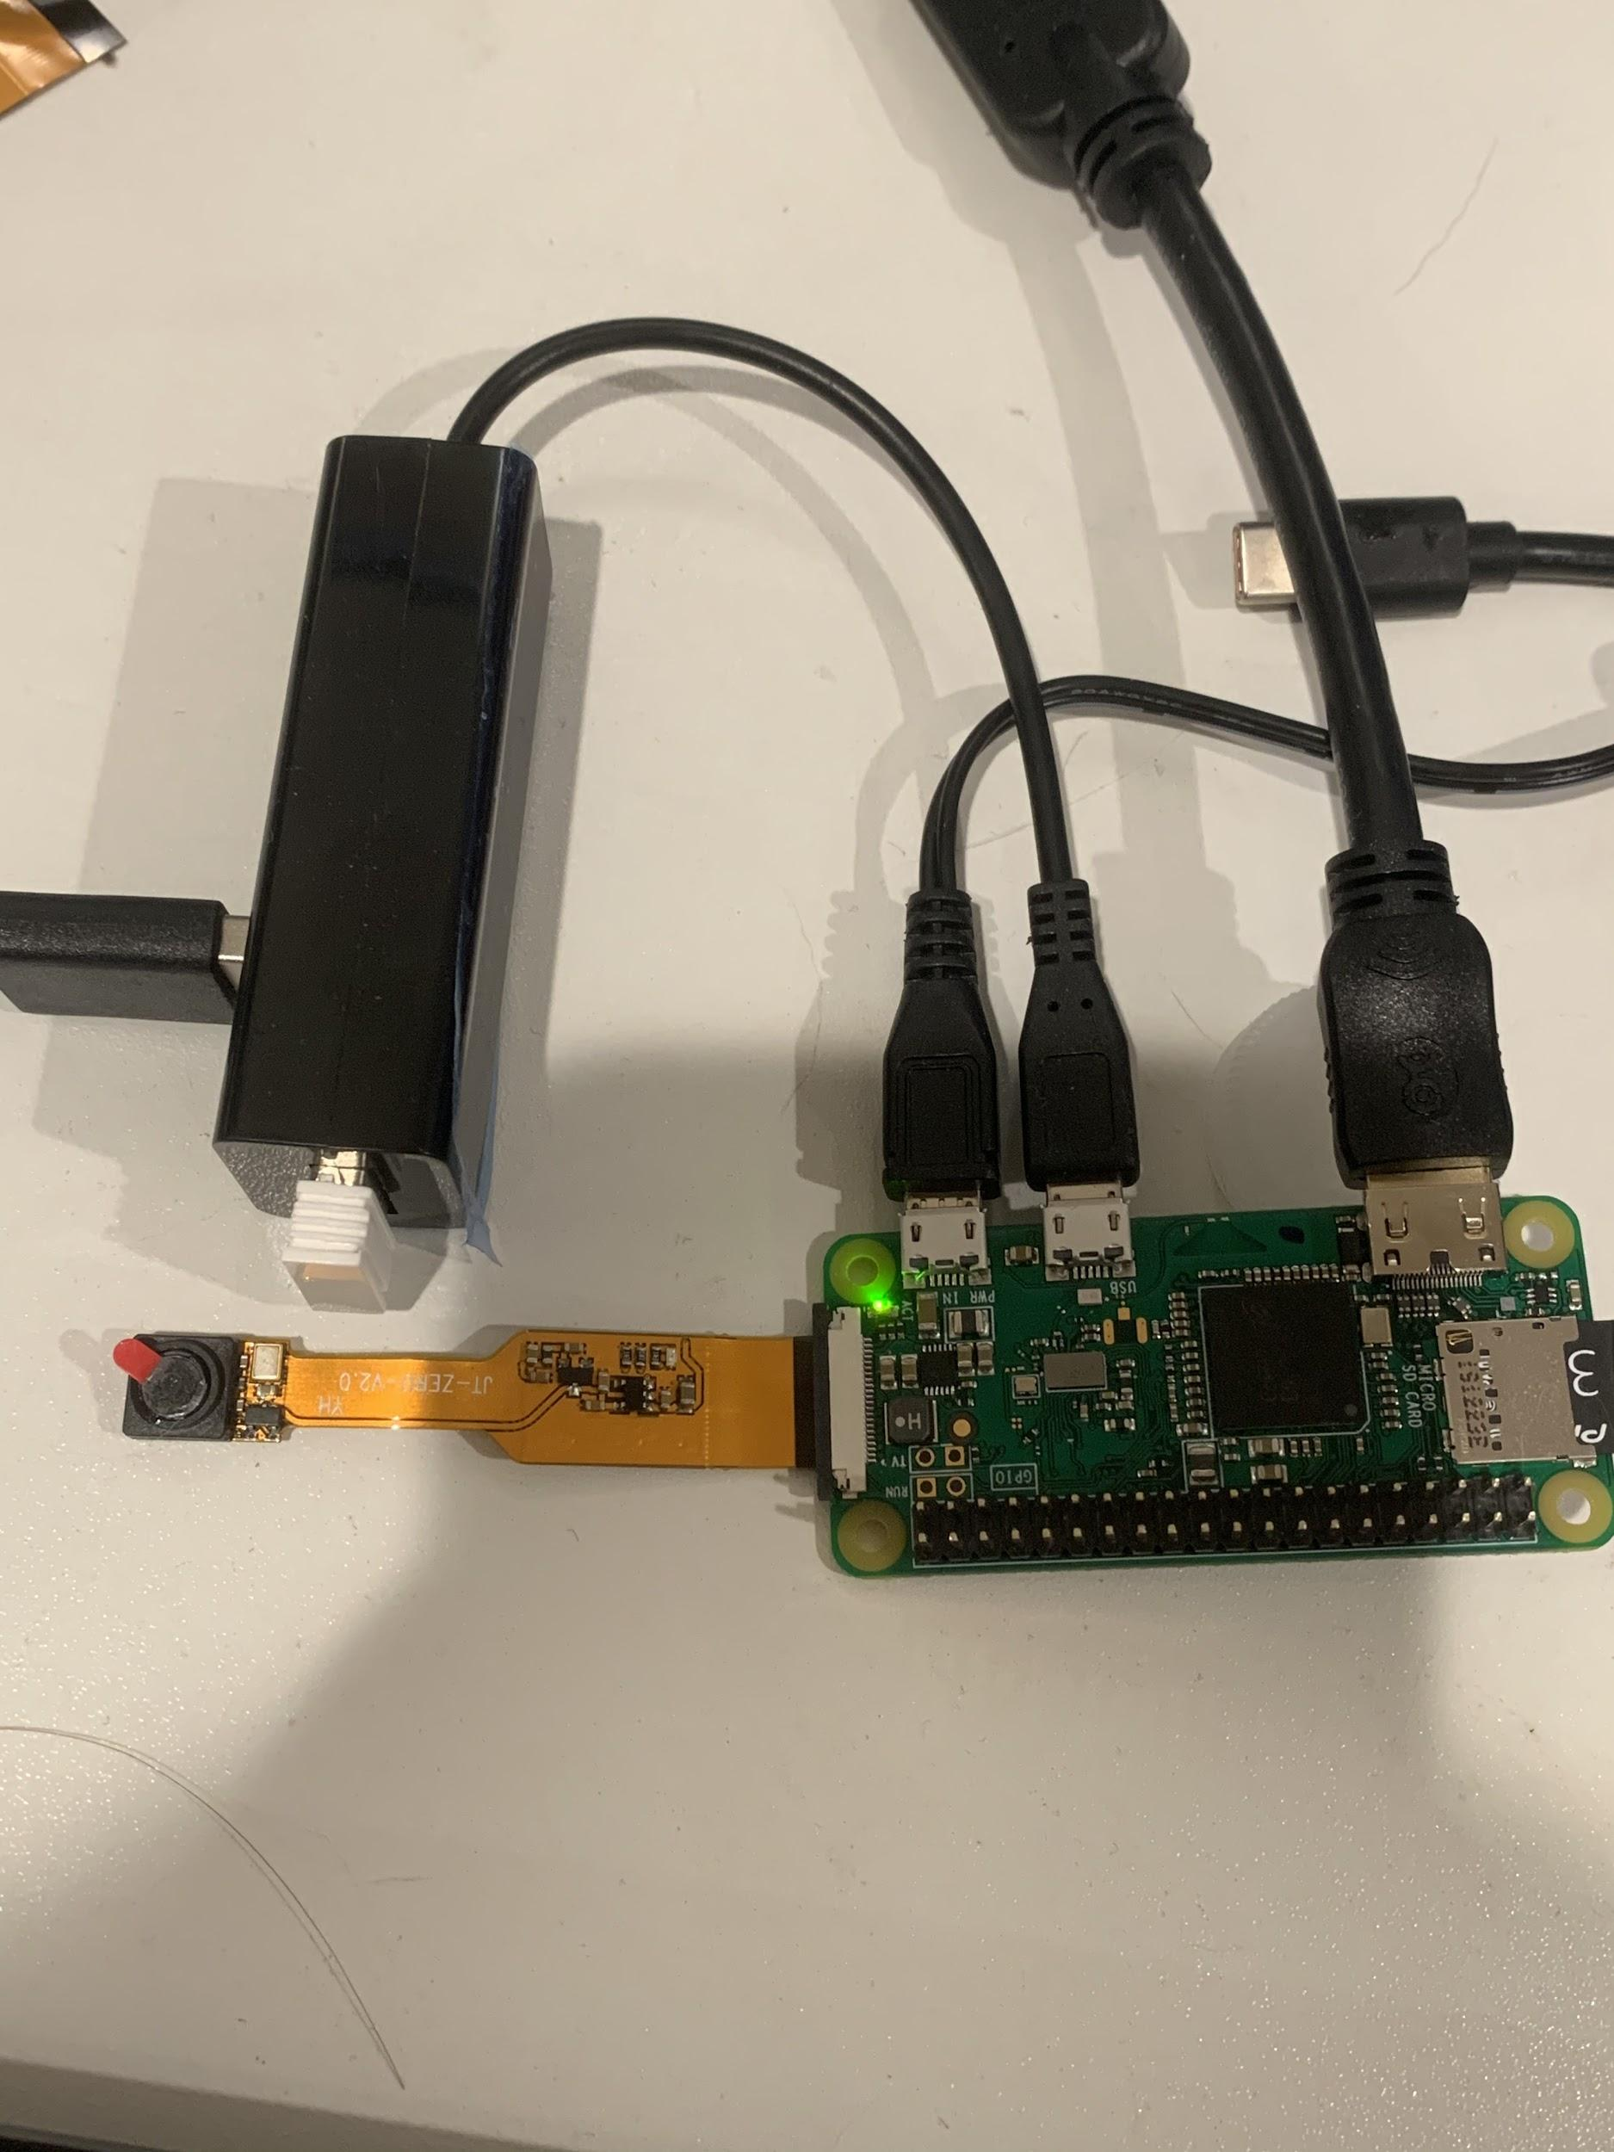
Raspberry Pi Zero + Spy Cam
RPI 0
1GHz, single-core CPU
512MB RAM
Micro USB power
HAT-compatible 40-pin header
8g
Spy Cam
5 MP
8.6mm x 8.6mm x 5.2mm / .34" x .34" x .2"
Lens Diameter: 6.9mm
Cable Length: 52mm
Weight: 1.1g

Slide 3
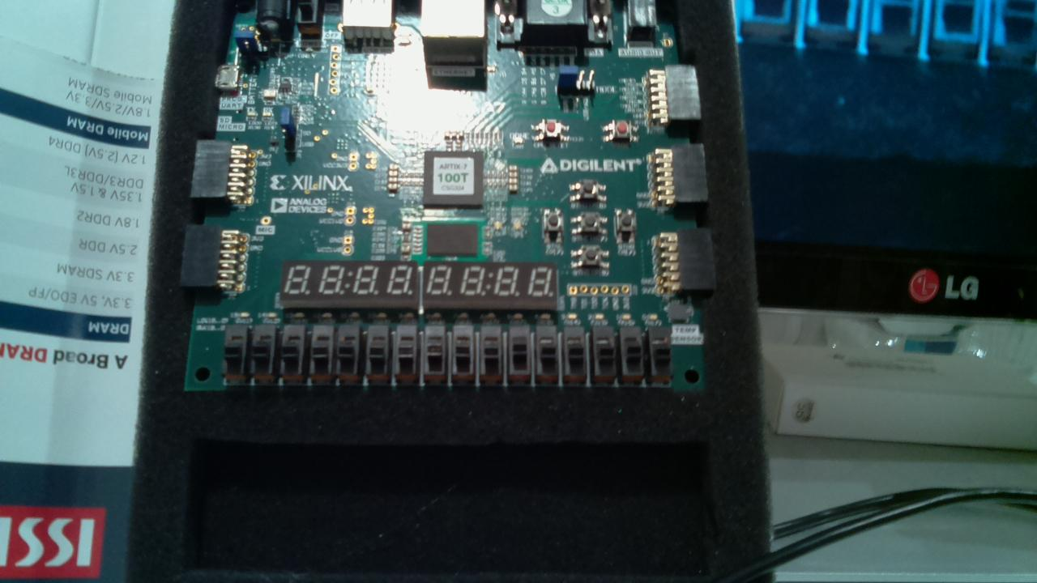
Testing Image
600kb
2592 × 1944 pixels

Slide 4

Testing Video

Slide 5
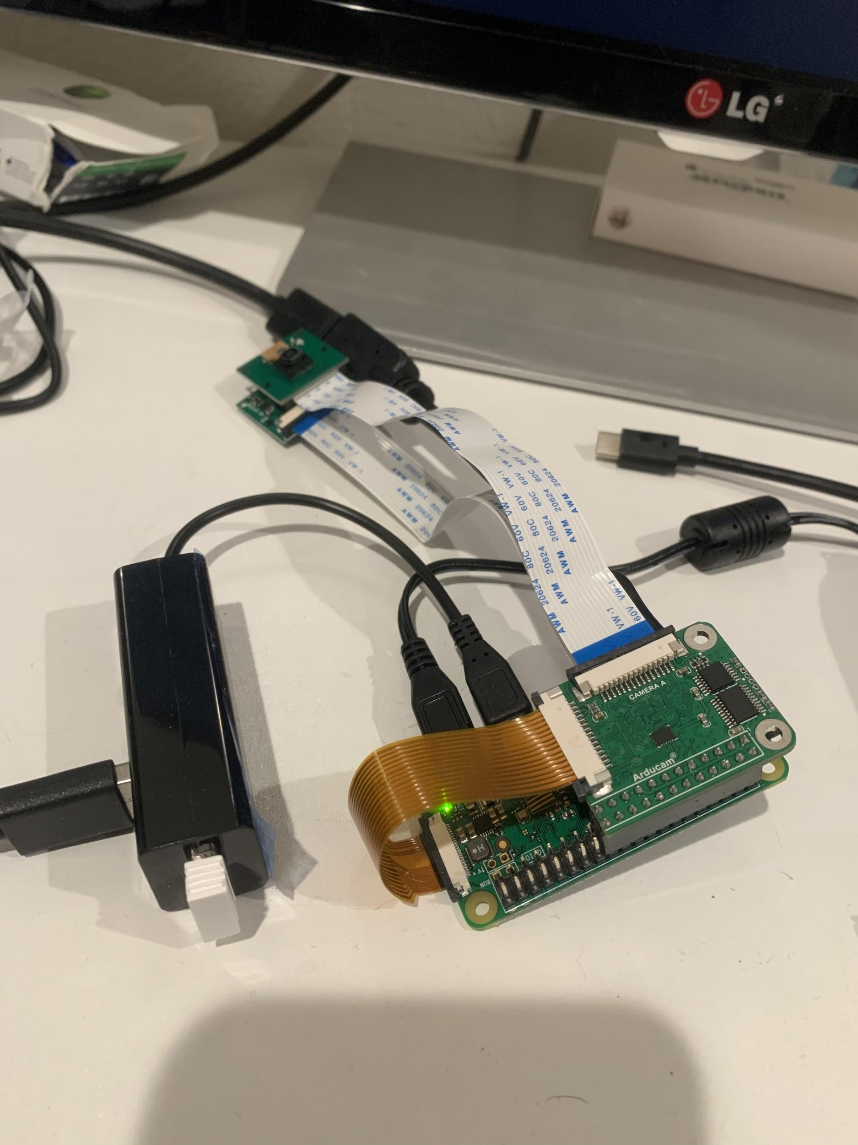
Raspberry Pi Zero + Arducam Doubleplexer+ two cameras
RPI 0
1GHz, single-core CPU
512MB RAM
Micro USB power
HAT-compatible 40-pin header
8g
Duobleplexer
Allows for two 5/8MP cameras

Slide 6
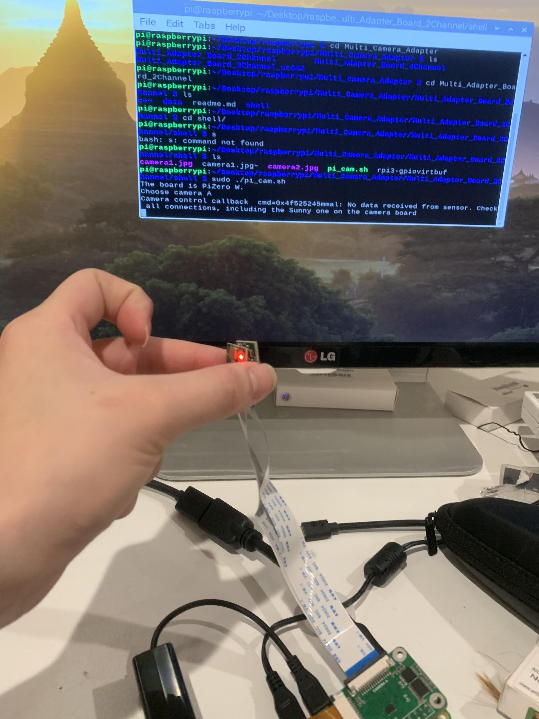
Arducam Multi Camera Adapter Doubleplexer
Current issue
Both cameras have red lights on(cameras are being detected) , but no data from the camera

Slide 7
Future
Figuring out how to read data from the RunCam
Would this camera be used for World view?
Might be more easier to use a different board or than then Raspberry Pi
Fixing issue with ArduCam Mux
Determining mux IC needed for board
Purchasable from Digikey
Question
What other tests should we perform on the current cameras?
Could we get insight from Cris’s lab on how to read data from RunCam?

Slide 8
MouseCam Project
1/17/2021
Ian, Emmanuel

Slide 9
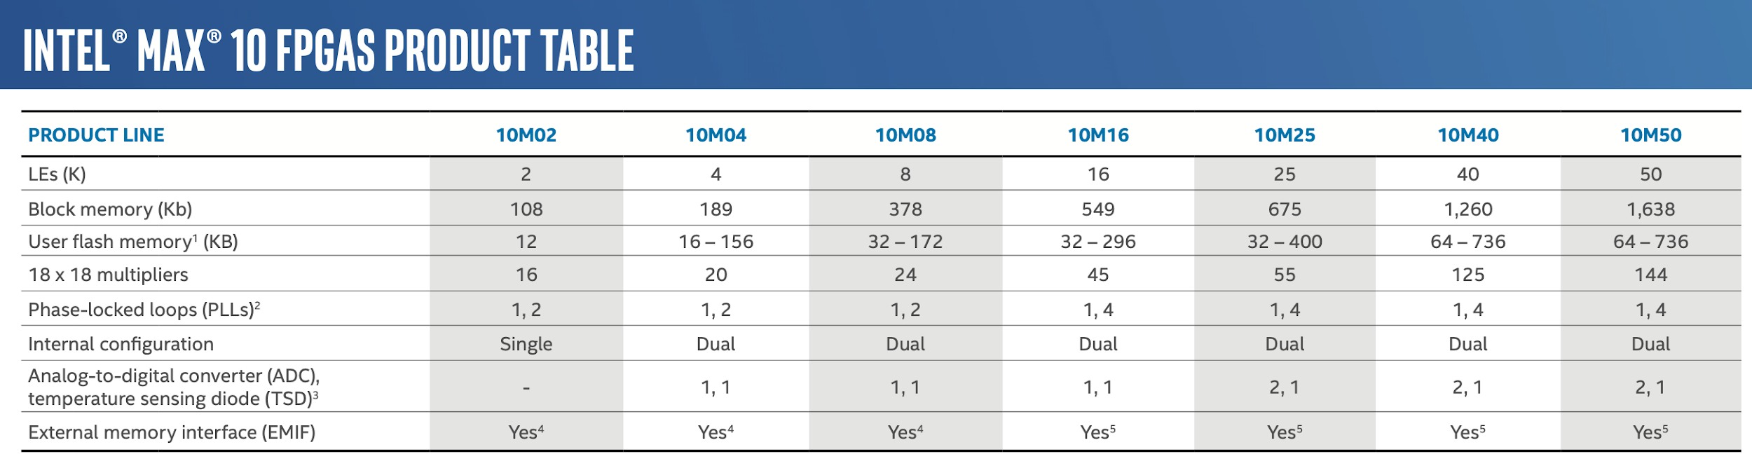
Intel Max 10 FPGA Choice

Slide 10
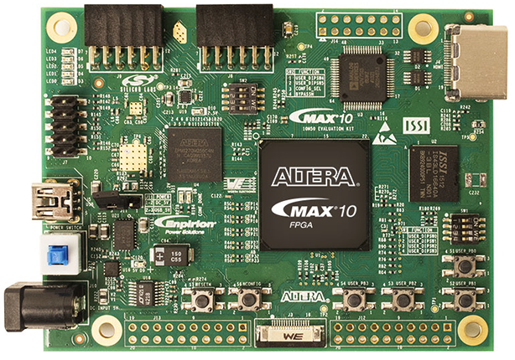
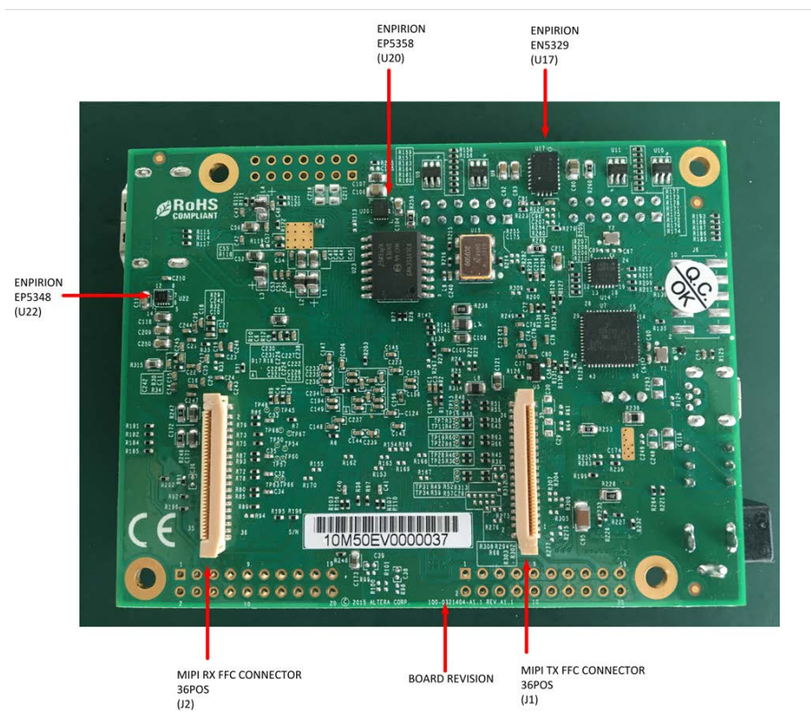
Max 10 FPGA Evaluation Board: EK-10M50F484
Spec
MAX 10 FPGA - 10M50D
Two MIPI CSI-2 Inputs
1.3MP image sensor (OV10640)
5MP image sensor (OV5640)
Two (2x10) GPIO
MIPI CSI-2 Camera Inputs
GPIO Pins
Link: https://www.digikey.com/en/products/detail/intel/EK-10M50F484/5766903 Datasheet:https://www.mouser.com/datasheet/2/612/10M50_evaluation_board_userguide-1304871.pdf

Slide 11
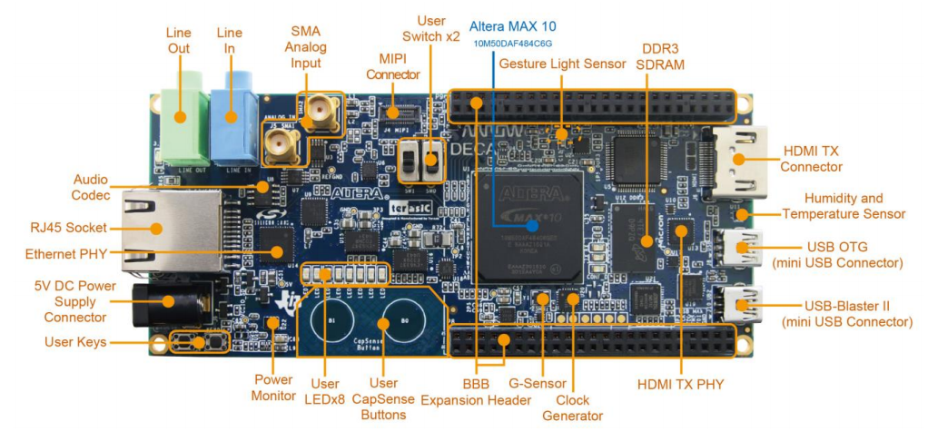
DECA Development Kit
Spec
MAX 10 FPGA - 10M50D
One MIPI CSI-2 Inputs
two 46(2x23)-pin expansion
Link: https://www.arrow.com/en/products/deca/arrow-development-tools Datasheet: https://static6.arrow.com/aropdfconversion/efb389d1f9c390cf04346a67dbcda75f31d01f43/deca_user_manual.pdf

Slide 12
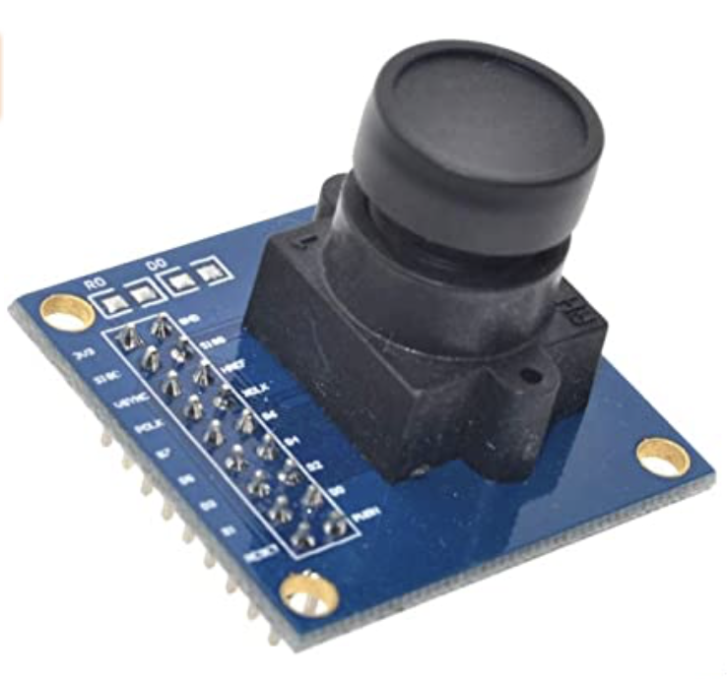
Testing Max10 Dev-Board with OV7670 Cameras
Spec
Pixel array size: 640x480
0.3MP @ 30fps
8-bits

Slide 13

Design Update: MouseCam V1.3
Python480
0.48MP
@
60 fps
FPGA
(Max 10 10M50)
Serializer (DS90UB913Q-Q1)
Deserializer (DS90UB954-Q1)
HOST PC
15m long Coax Cable
Python480
0.48MP
@
60 fps

